Slide 1

Business Analyst
(Aug 2023-Dec 2024)

Slide 2
Data-Driven Disease Prediction: A Chronic Risk Analysis
UNDER THE GUIDANCE OF
Zeyana Hamid
By
Naga Praneeth Cheela

Slide 3
AGENDA
INTRODUCTION
PATIENT DEMOGRAPHICS
MEDICAL HISTORY
LABORATORY TESTS
DATA CLEANING AND DATA PREPROCESSING
EXPLORATORY DATA ANALYSIS
DATA PREPARATION
PRINCIPAL COMPONENT ANALYSIS (PCA)
ISOLATION FOREST
ANALYSIS OF MULTI-TARGET CLASSIFICATION
STATISTICAL HYPOTHESIS TESTING
CONCLUSION

Slide 4
INTRODUCTION
PROJECT GOAL
Predicting and Understanding Chronic Conditions: Our focus is on predicting and analyzing conditions such as hypertension, diabetes, heart disease, and chronic kidney disease (CKD).
Initial Dataset: The analysis begins with the Diabetes Prediction Dataset sourced from Kaggle. Original Dataset: 100,000 rows and 9 columns.
Target Variables: We aim for multi-target classification by incorporating multiple targets for prediction: Diabetes, Hypertension, Heart Disease and Chronic Kidney Disease (CKD).
Feature Expansion: Additionally, manually incorporated features essential for healthcare predictive analysis include Heart Disease, GFR, CKD Stages, Systolic and Diastolic Blood Pressure etc.
Final Dataset has total rows 100,000 (unchanged from the original dataset). Updated Features: Columns/features have been updated to match the specific requirements for this multi-target healthcare analysis.

Slide 5
KEY FEATURES
Patient Demographics: Patient ID, age, gender, residence type, income level, employment status, insurance type, admission type.
Medical History: Hypertension, diabetes, heart disease, CKD, chest pain, smoking history, BMI, obesity, comorbidities, previous surgeries, previous hospitalizations, family history illnesses.
Laboratory Values : Blood pressure, ECG, heart rate, exercise angina, Old Peak, ST slope, cholesterol level tests, liver tests, thyroid hormones, GFR, blood glucose levels.
Lifestyle Factors & Habits : Diet, exercise, substance use, health status (At Risk/No Risk).
Medications: Medications currently used by patients

Slide 6
PATIENTS DEMOGRAPHICS
Setting up the Data:
Sample Size: 100,000 rows generated for the dataset.
Random Seed: Set for reproducibility.
2. ID: Assigned unique random integers ranging from 100,000 to 999,999.
3. Gender: Randomly assigned with a slight imbalance (52% Female, 48% Male).
4. Age Categories & Simulation: Age Groups: Generated based on the following probabilities:
0-18: 10%, 19-35: 20%, 36-55: 30%, 56-75: 25%, 76+: 15%
Age Values: Age assigned based on the categories (randomized within age ranges).
5. Residence Type: Rural/Urban: Assigned randomly based on a 50/50 distribution.
6. Income Level: Income Assignment: Different income levels assigned based on age:
Young adults (19-35) have a higher chance for medium income, while older adults (56+) are more likely to have low income.

Slide 7
7. Employment Status: Age-Based Assignment:
Children (<18): Assigned "Student.“
Adults: Random assignment of employment status (Employed, Self-Employed, etc.), with specific probabilities.
Adjustments: Employment status probabilities normalized to exclude 'Not in Labor Force.’
8. Insurance Type:
Types: Random assignment with probabilities: Private Insurance: 40%, Public Insurance: 30%, Uninsured: 20%, and others.
9. Admission Type: Admission classified as either 'Emergency' (E) or 'Outpatient' (O) based on random assignment.
Significance of Patients Demographics Features in Analysis
Age | Influences risk for chronic conditions (e.g., diabetes, heart disease)
Gender | Affects prevalence and treatment of various conditions
Residence Type | Highlights healthcare access disparities
Income Level | Impacts healthcare access and chronic disease risk
Employment Status | Reflects socioeconomic factors influencing health
Insurance Types | Affects access to preventive care and treatment
Admission Types | Indicates severity of health conditions and care management

Slide 8
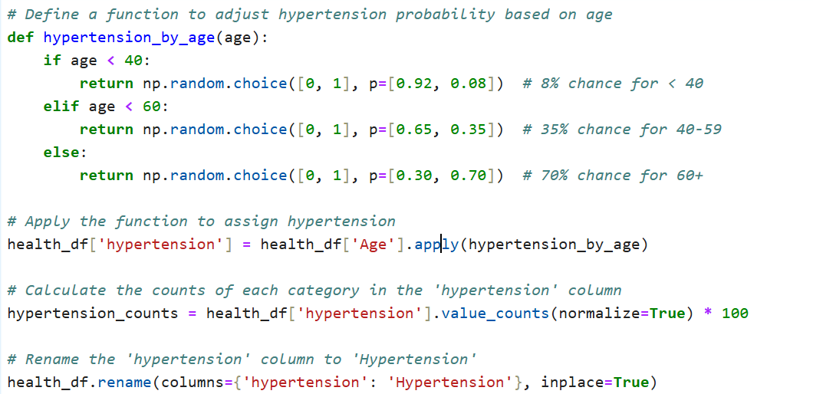
PAST MEDICAL HISTORY
Description of Hypertension
Hypertension: A medical condition characterized by high blood pressure. For modeling purposes:
Individuals aged below 40 have an 8% chance of being hypertensive.
Those aged 40–59 have a 35% chance.
Individuals aged 60 and above have a 70% chance.

Slide 9
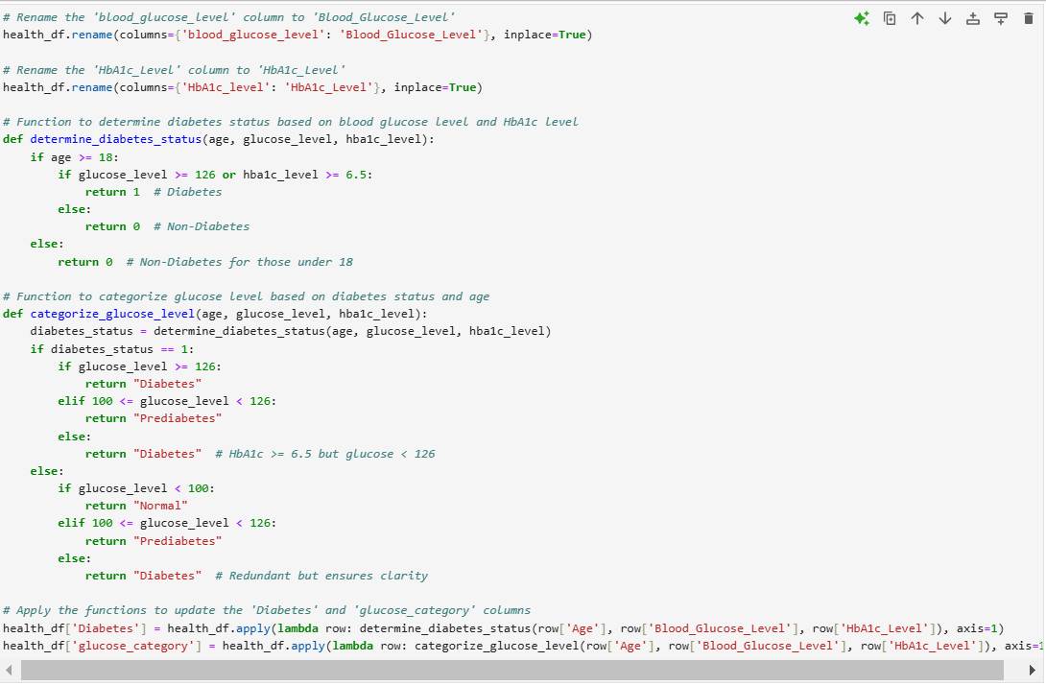
Diabetes Determination Function
Determines diabetes status based on standard thresholds for blood glucose level (≥126 mg/dL) and HbA1c level (≥6.5%).
Assumes individuals under 18 do not have diabetes, which may simplify logic for some cases.
Glucose Level Categorization
Categorizes individuals into Normal, Prediabetes, or Diabetes based on thresholds.
Redundant checks like else: return "Diabetes" for glucose_level < 126 ensure clarity but could be streamlined.

Slide 10
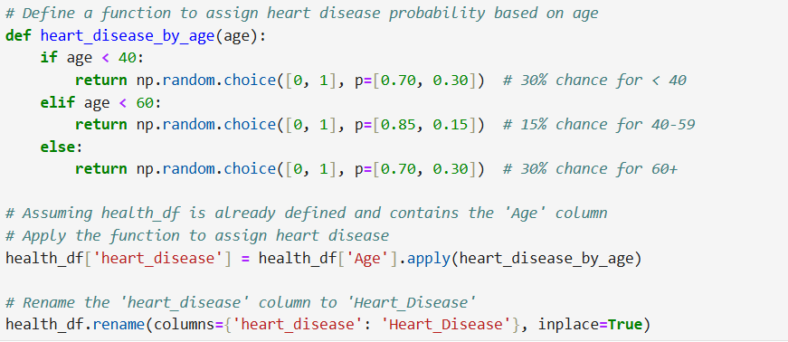
Heart Disease Probability Assignment
Objective: Predict the likelihood of heart disease based on age groups.
Dataset: Health data containing age and other relevant factors.
Methodology:
Probability values assigned based on predefined percentages for age ranges.
Probability levels reflect empirical or observed trends.
Age Group | Heart Disease Probability
< 40 years | 30% (70% no heart disease)
40–59 years | 15% (85% no heart disease)
≥ 60 years | 30% (70% no heart disease)

Slide 11
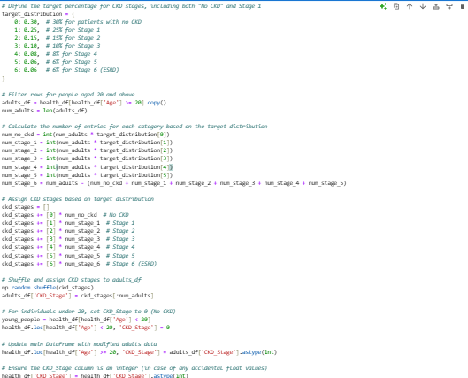
Chronic Kidney Disease (CKD) Staging in the Dataset
Objective: Assign CKD stages to individuals in the dataset based on predefined distributions and ensure logical alignment with age demographics.
Dataset: Simulated health data containing age and other relevant attributes.
CKD Stages:
Stage 0: No CKD
Stage 1–5: Progressive CKD stages
Stage 6: End-Stage Renal Disease (ESRD)
CKD Stage | Description | Target %
0 | No CKD | 30%
1 | Mild Kidney Damage | 25%
2 | Mild to Moderate Damage | 15%
3 | Moderate Damage | 10%
4 | Severe Damage | 8%
5 | Kidney Failure | 6%
6 | ESRD (Dialysis Required) | 6%

Slide 12
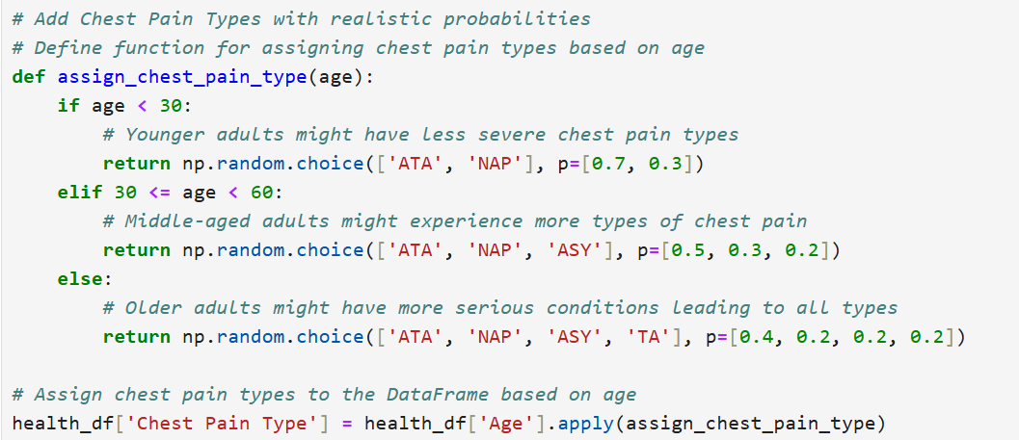
Chest Pain Type Analysis in Dataset
Objective: Assign chest pain types to individuals based on age demographics, reflecting realistic probabilities of different types of chest pain.
Dataset Context: Simulated health dataset containing age and other related health attributes.
Assignment Based on Age:
Type | Description
ATA | Atypical Angina
NAP | Non-Anginal Pain
ASY | Asymptomatic
TA | Typical Angina
Age Group | Characteristics | Chest Pain Type Distribution
Age < 30 | Higher likelihood of less severe pain types. | ATA (70%), NAP (30%)
Age 30–59 | Greater diversity in chest pain types as risks increase. | ATA (50%), NAP (30%), ASY (20%)
Age ≥ 60 | Older adults may experience more severe and varied conditions. | ATA (40%), NAP (20%), ASY (20%), TA (20%)

Slide 13
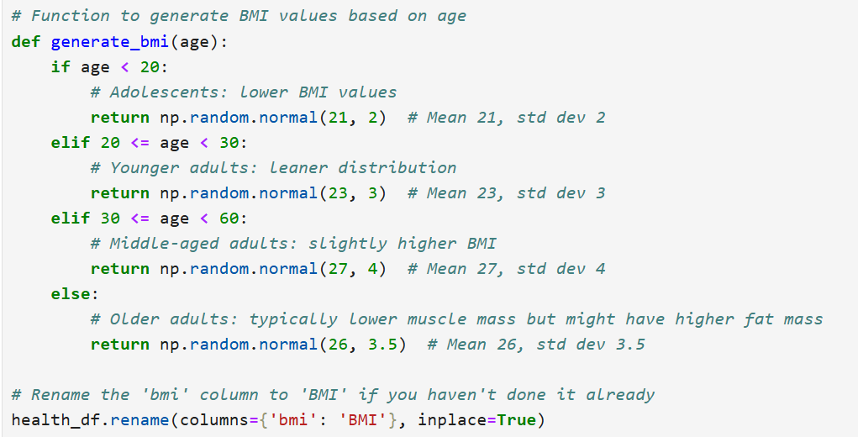
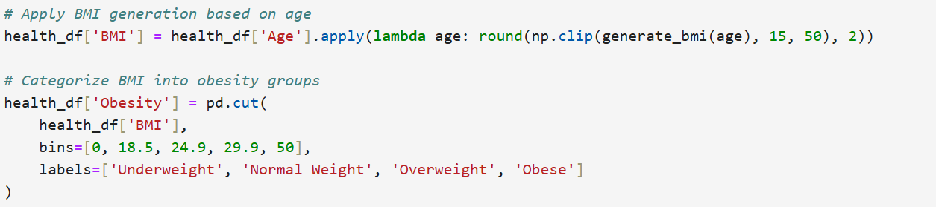
BMI and Obesity Analysis in Dataset
Objective: Simulate realistic BMI values and classify individuals into obesity categories based on age.
Dataset Context: Leveraging a health dataset to examine Body Mass Index (BMI) and its implications on health.
Age Group | Characteristics | BMI Mean | BMI Standard Deviation
Age < 20 | Lower BMI reflecting adolescent growth. | 21 | 2
Age 20–29 | Leaner adults, active lifestyle. | 23 | 3
Age 30–59 | Middle-aged adults with increased BMI. | 27 | 4
Age ≥ 60 | Older adults with shifting body composition. | 26 | 3.5
Range | Category
< 18.5 | Underweight
18.5–24.9 | Normal Weight

Slide 14
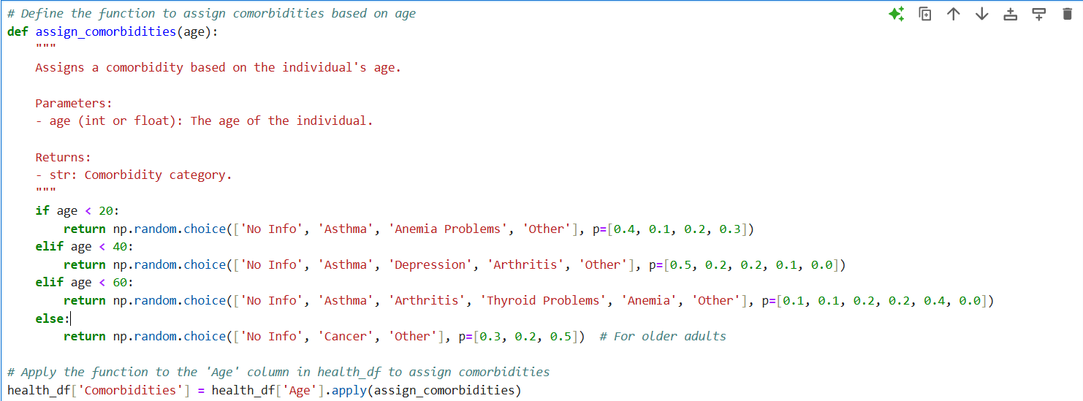
Comorbidities Analysis in Dataset
Objective: Assign realistic comorbidities to individuals based on their age.
Dataset Context: Understanding the prevalence of different comorbidities in various age groups.
Age Group | Asthma | Anemia Problems | Arthritis | Depression | Thyroid Problems | Cancer | Other | No Info
Age < 20 | 10% | 20% | - | - | - | - | 30% | 40%
Age 20–39 | 20% | - | 10% | 20% | - | - | 50% | -
Age 40–59 | 10% | 40% | 20% | - | 20% | - | 10% | -
Age ≥ 60 | - | - | - | - | - | 20% | 50% | 30%

Slide 15
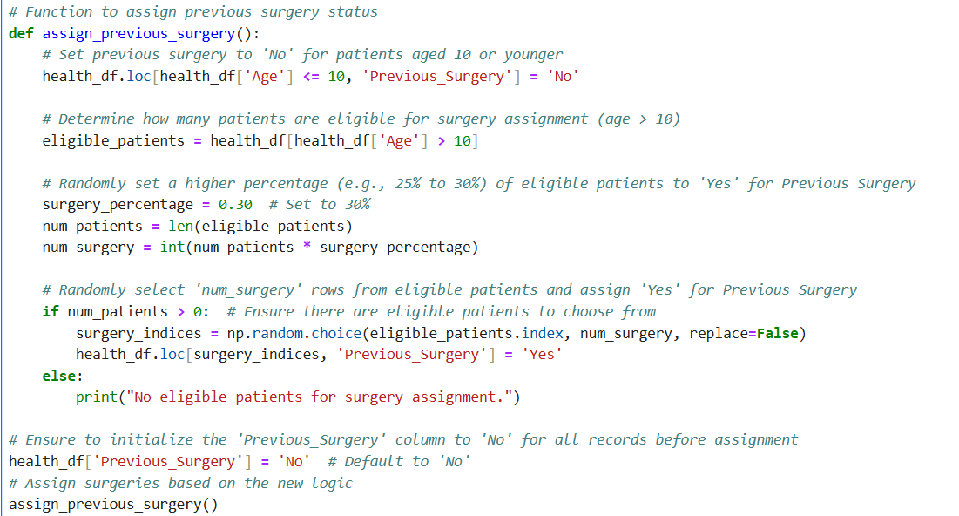
Previous Surgeries Assignment in Dataset
Goal: Assign whether individuals have had previous surgeries based on age, with a specific probability distribution for those older than 10 years.
Age Group | Previous Surgery Status | Reason | Implementation | Outcome
Age ≤ 10 | No | Younger individuals are less likely to have undergone surgeries. | All individuals ≤ 10 years old are assigned 'No' for Previous Surgery. | New Column Added: Previous_Surgery, defaulted to 'No'.
Age > 10 | 30% chance of 'Yes' | Older individuals might have a higher likelihood of surgeries. | 30% of individuals > 10 years old are randomly assigned 'Yes'. | Approximately 30% of individuals aged above 10 will have 'Yes' for Previous Surgery.

Slide 16
Previous Hospitalization Status Based on Health Conditions
Goal: To determine whether individuals have had previous hospitalizations based on their health conditions, using a function that assesses the likelihood of hospitalization due to various health issues.
Condition | Previous Hospitalization Status | Reason | Implementation | Outcome
High Hospitalization Conditions | Yes | Conditions such as CKD, Heart Disease, Diabetes, Cancer, and others are associated with a higher likelihood of hospitalization. | Individuals with any of these conditions are assigned 'Yes' for previous hospitalizations. | New Column Added: Previous_Hospitalization, assigned 'Yes' for high-risk conditions.
Hypertension | No | Hypertension is typically associated with fewer hospitalizations. | Individuals with hypertension alone are assigned 'No' for previous hospitalizations. | Assigned 'No' for individuals with only hypertension.
Multiple Comorbidities | Yes | Individuals with multiple comorbidities are assumed to have had higher hospitalizations. | If an individual has multiple comorbidities, they are more likely to have had previous hospitalizations. | Assigned 'Yes' for individuals with multiple comorbidities.
Unspecified Conditions | No | Individuals without any specified high-risk conditions or comorbidities are assigned 'No'. | Individuals without high-risk conditions are assigned 'No' for previous hospitalizations. | Assigned 'No' for individuals with unspecified conditions

Slide 17
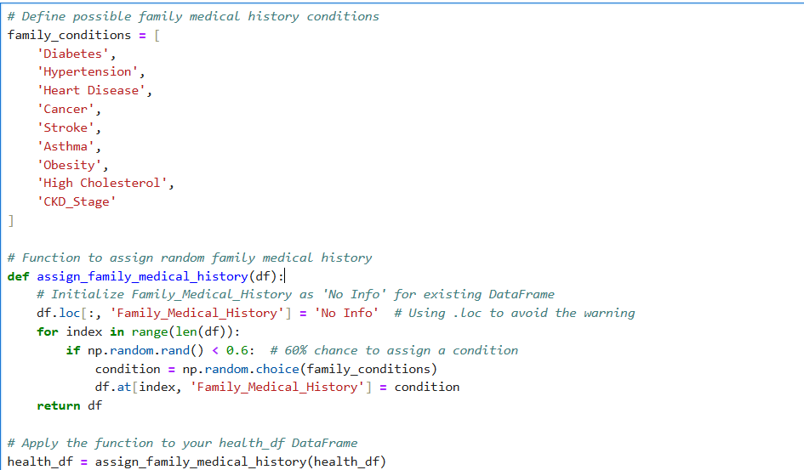
Family Medical History
A predefined list of family medical conditions is considered, including Diabetes, Hypertension, Heart Disease, Cancer, Stroke, Asthma, Obesity, High Cholesterol, Chronic Kidney Disease (CKD).
Methodology
60% Probability of Condition Assignment: Each individual has a 60% chance of having a relevant family medical history condition.
Condition Assignment: If the individual is selected (based on random probability), a condition is randomly chosen from the list of possible family medical history conditions.
Default for No Info: If no condition is assigned, the family medical history is set to 'No Info’.

Slide 18
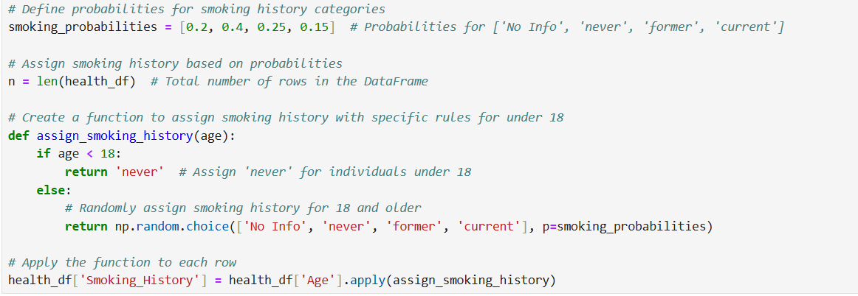
Smoking History
Goal: To assign smoking history to individuals in the dataset based on age and defined probabilities. This helps in assessing the correlation between smoking and health conditions.
Smoking History Categories: The smoking history is categorized into the following groups:
No Info': No information available about smoking status.
'never': Individuals who have never smoked.
'former': Individuals who used to smoke but have quit.
'current': Individuals who are currently smoking.
Probabilities for Smoking Categories: The probability distribution for assigning smoking history is as follows:
20% chance for 'No Info'
40% chance for 'never'
25% chance for 'former'
15% chance for 'current’
If under 18, assign smoking history as 'never'.
If 18 or older, randomly assign a smoking history using the given probabilities.

Slide 19
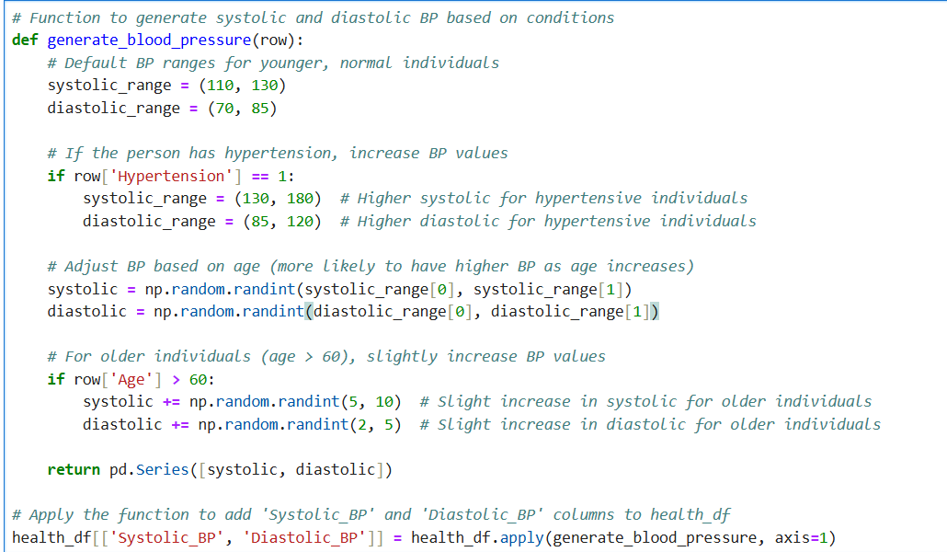
LABORATORY TESTS
Generating Blood Pressure Values
Goal: To simulate the generation of systolic and diastolic blood pressure (BP) values for individuals based on health conditions and age. This is crucial for understanding the relationship between hypertension, age, and blood pressure levels.
Blood Pressure Categories
Systolic BP: Pressure during heartbeats (upper number).
Diastolic BP: Pressure when the heart rests between beats (lower number).
Adjustments
Hypertension: Systolic: 130–180 mmHg AND Diastolic: 85–120 mmHg
Age Impact (>60): Systolic: +5–10 mmHg AND Diastolic: +2–5 mmHg
Default (Healthy, <60): Systolic: 110–130 mmHg AND Diastolic: 70–85 mmHg

Slide 20
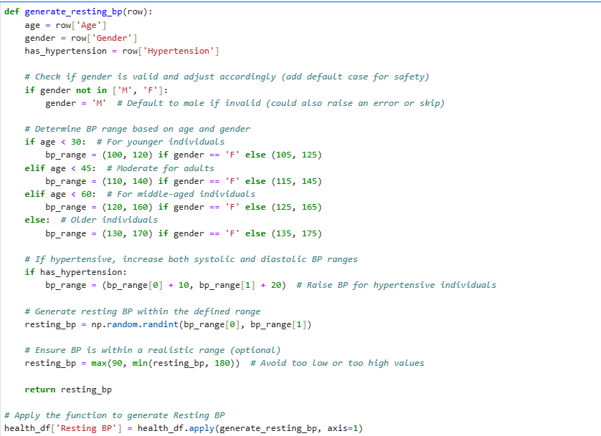
Generating Resting Blood Pressure (BP)
Goal: To simulate the generation of Resting Blood Pressure (BP) values based on age, gender, and hypertension status. This is a key indicator for cardiovascular health, helping to assess risks of heart disease and other conditions.
Category | Details
Resting BP Overview | Reflects baseline cardiovascular health.
Systolic BP | Pressure during heartbeats.
Diastolic BP | Pressure when the heart rests.
Factors Influencing BP
Age | <30: Lower BP, 30-60: Moderate BP, >60: Higher BP
Gender | Females usually have slightly lower BP.
Hypertension | Increases BP values.
BP Ranges by Age and Gender
<30 years | Females: 100-120 mmHg, Males: 105-125 mmHg
30-45 years | Females: 110-140 mmHg, Males: 115-145 mmHg
45-60 years | Females: 120-160 mmHg, Males: 125-165 mmHg
>60 years | Females: 130-170 mmHg, Males: 135-175 mmHg
Adjustments for Hypertension
Systolic BP | +10 mmHg
Diastolic BP | +20 mmHg
Implementation | BP generated based on age, gender, and hypertension (90-180 mmHg).
Key Insights | Hypertension leads to higher BP; Age and gender help tailor healthcare strategies.
Next Steps | Analyze BP patterns across demographics; Integrate BP with other health data for risk assessments.

Slide 21
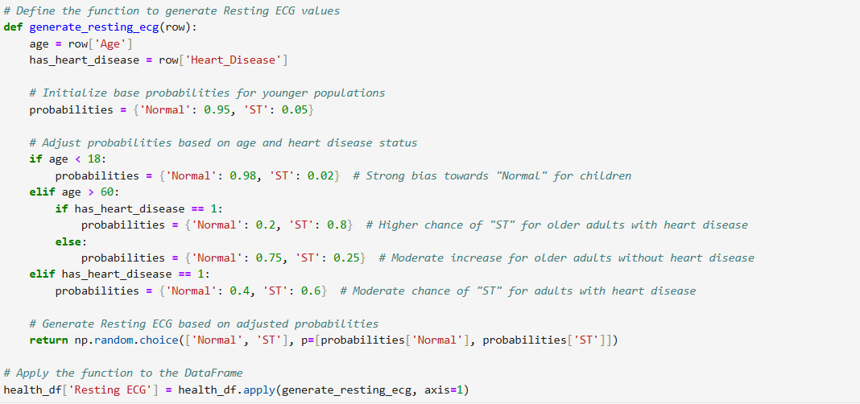
Generating Resting ECG Values
Goal: To simulate the generation of Resting Electrocardiogram (ECG) values based on an individual's age and heart disease status. This is a key diagnostic tool for evaluating heart health.
Category | Details
Resting ECG Overview | Measures the electrical activity of the heart while at rest, providing insights into heart rhythm and potential abnormalities.
Resting ECG Results | Normal: Healthy heart rhythm. ST: ST-segment changes, potentially indicating heart disease (ischemia or infarction).
Factors Influencing Resting ECG
Age | Children (<18): More likely to have normal ECG. Older adults (>60): More likely to have ST-segment changes, especially with heart disease.
Heart Disease Status | Individuals with heart disease are more likely to have ST-segment changes.
Adjusted Probabilities for Resting ECG
Under 18 years | Normal ECG: 98% chance, ST-segment change: 2% chance
Over 60 years (with heart disease) | Normal ECG: 20% chance, ST-segment change: 80% chance
Over 60 years (without heart disease) | Normal ECG: 75% chance, ST-segment change: 25% chance
18-60 years (with heart disease) | Normal ECG: 40% chance, ST-segment change: 60% chance
18-60 years (without heart disease) | Normal ECG: 95% chance, ST-segment change: 5% chance
Function Implementation | Generates Resting ECG based on age and heart disease status, adjusting probabilities accordingly.
Probability Adjustments | Adjusts probabilities based on age and heart disease status for realistic ECG outcomes.
Key Column Generated | Resting ECG reflects heart’s electrical activity, offering insights into heart issues.
Health Insights | Heart disease increases likelihood of ST-segment changes. Age affects ECG results, especially with heart disease.
Next Steps | Monitor Resting ECG alongside other health indicators (e.g., blood pressure, cholesterol) for comprehensive cardiovascular assessment. Investigate correlations with hypertension, diabetes, and lifestyle factors.

Slide 22
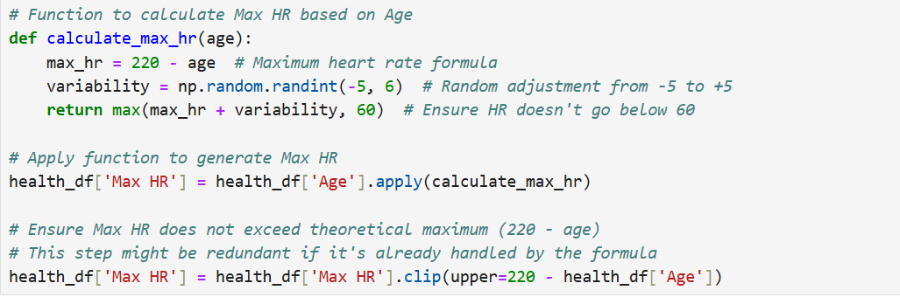
Calculating Maximum Heart Rate (Max HR)
What is Max HR? Max Heart Rate (Max HR) is the highest bpm an individual's heart can achieve during intense activity. It helps assess cardiovascular health and plan exercise regimens.
Max HR Calculation: Formula: Max HR = 220 − Age. As age increases, Max HR decreases.
A random adjustment of ±5 bpm simulates natural fluctuations due to fitness, genetics, and health.
Function Implementation: Calculation: Max HR is calculated based on age and adjusted by ±5 bpm.
Clipping: Ensures Max HR is between 60 bpm and the theoretical Max HR.
Example Calculation:
For a 30-year-old: Max HR = 220 − 30 = 190 (range: 185-195 bpm).
For a 60-year-old: Max HR = 220 − 60 = 160 (range: 155-165 bpm).
Key Insights: Age Impact: Max HR decreases with age, influencing exercise intensity.

Slide 23
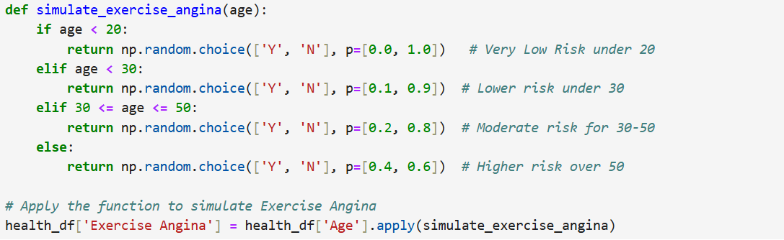
Simulating Exercise Angina
What is Exercise Angina? Exercise Angina refers to chest pain or discomfort that occurs during physical activity due to insufficient oxygen supply to the heart. It is a key indicator of heart disease or cardiovascular problems.
Age Group | Risk of Exercise Angina | Probability of Angina (%) | Simulated Outcome
Under 20 years | Very low risk | 0% | "N" (No angina)
Under 30 years | Low risk | 10% | "Y" or "N" (Low risk)
30–50 years | Moderate risk | 20% | "Y" or "N" (Moderate risk)
Above 50 years | Higher risk | 40% | "Y" or "N" (Higher risk)

Slide 24
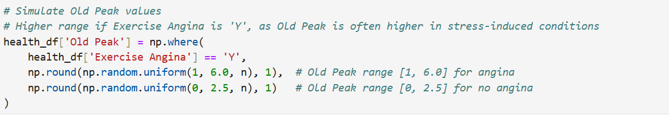
Simulating Old Peak Values
Goal: To simulate the Old Peak values based on the presence of Exercise Angina in the dataset, reflecting the severity of stress-induced heart conditions.
Key Insights:
Higher Old Peak (1.0–6.0) is associated with exercise angina, indicating more stress on the heart.
Lower Old Peak (0.0–2.5) occurs in individuals without exercise angina, suggesting less heart stress during physical exertion.
Condition | Exercise Angina (Y/N) | Old Peak Range | Old Peak Value Simulation
With Exercise Angina (Y) | Yes | 1.0 - 6.0 | Random value between 1.0 and 6.0
Without Exercise Angina (N) | No | 0.0 - 2.5 | Random value between 0.0 and 2.5

Slide 25
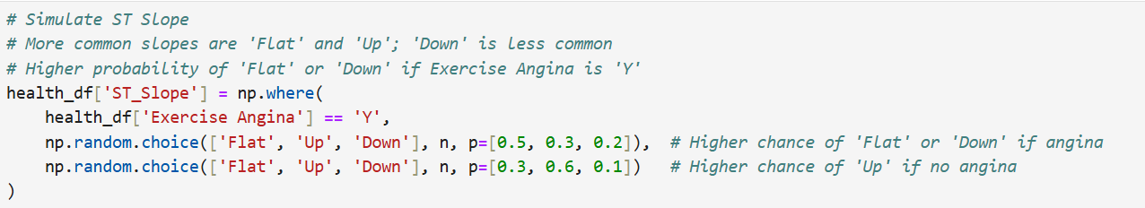
Simulating ST Slope
Goal: To simulate the ST Slope values, considering the presence of Exercise Angina, reflecting heart stress during physical activity.
Key Insights:
Flat or Down Slope: Associated with Exercise Angina, indicating heart stress or ischemia.
Upward Slope: Typically indicates normal heart function without exercise-induced stress.
Exercise Angina (Y/N) | ST Slope Simulation | Probability
With Exercise Angina (Y) | Flat | 50%
 | Up | 30%
 | Down | 20%
Without Exercise Angina (N) | Flat | 30%
 | Up | 60%
 | Down | 10%

Slide 26
Generating Age- and Gender-Appropriate Lipid Values
Goal: To simulate lipid panel values (Total Cholesterol, LDL, HDL, and Triglycerides) based on age and gender for individuals in the health dataset.
What is a Lipid Panel? A lipid panel measures various types of cholesterol and lipids in the blood:
Total Cholesterol: Measures overall cholesterol levels.
LDL Cholesterol: Often referred to as “bad” cholesterol; higher levels increase the risk of heart disease.
HDL Cholesterol: Known as “good” cholesterol; helps remove other forms of cholesterol from the bloodstream.
Triglycerides: A type of fat found in the blood; high levels are associated with increased risk of heart disease.
Key Insights:
Total Cholesterol & LDL: These values help assess the risk of heart disease, especially in older adults.
HDL Cholesterol: Higher levels protect against heart disease.
Triglycerides: High levels can indicate a risk of metabolic diseases like diabetes.
Age Range | Total Cholesterol (mg/dL) | LDL Cholesterol (mg/dL) | HDL Cholesterol (mg/dL) | Triglycerides (mg/dL)
<30 years | 120–200 | 50–100 (Optimal) | Men: 40–60, Women: 50–70 | Normal: <150, Borderline High: 150–199, High: >200
30–60 years | 150–240 | 50–130 (Optimal to Near Optimal) | Men: 40–60, Women: 50–70 | Normal: <150, Borderline High: 150–199, High: >200
>60 years | 160–260 | 100–250 (Near Optimal to Very High) | Men: 40–60, Women: 50–70 | Normal: <150, Borderline High: 150–199, High: >200

Slide 27
Generating Age- and Gender-Appropriate Liver Function Test Values
Goal: To simulate liver function test values (AST, ALT, and Alkaline Phosphatase) based on age and gender for individuals in the health dataset.
What is a Liver Function Test? Liver function tests (LFTs) measure enzymes and proteins in the blood to assess the health of the liver. Key components include:
AST (Aspartate Aminotransferase): Enzyme found in the liver, heart, and muscles; elevated levels can indicate liver damage.
ALT (Alanine Aminotransferase): Enzyme primarily in the liver; elevated levels often indicate liver inflammation.
Alkaline Phosphatase (ALP): Enzyme linked to bile ducts, liver, and bone health; elevated levels can indicate liver disease or bone conditions.
AST & ALT: Elevated levels may indicate liver damage or conditions like hepatitis or fatty liver.
Alkaline Phosphatase: High levels may suggest liver, bile duct, or bone issues.
Age Range | AST (U/L) | ALT (U/L) | Alkaline Phosphatase (U/L)
<18 years | 10–30 (children), 15–45 (men), 10–40 (women) | 7–35 (children), 10–60 (men), 7–50 (women) | 100–350 (higher in children)
18–60 years | 15–45 (men), 10–40 (women) | 10–60 (men), 7–50 (women) | 44–120 (adult range)
>60 years | 15–45 (men), 10–40 (women) | 10–60 (men), 7–50 (women) | 50–150 (slightly higher for older adults)

Slide 28
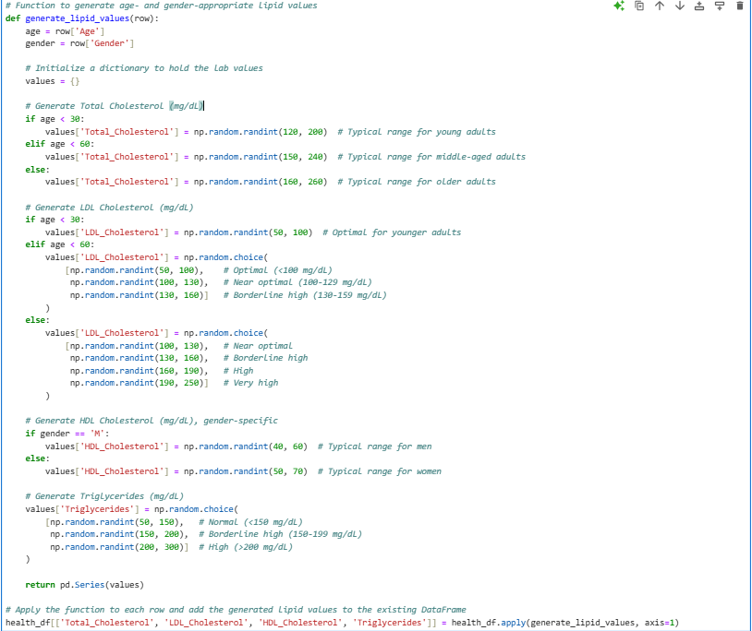
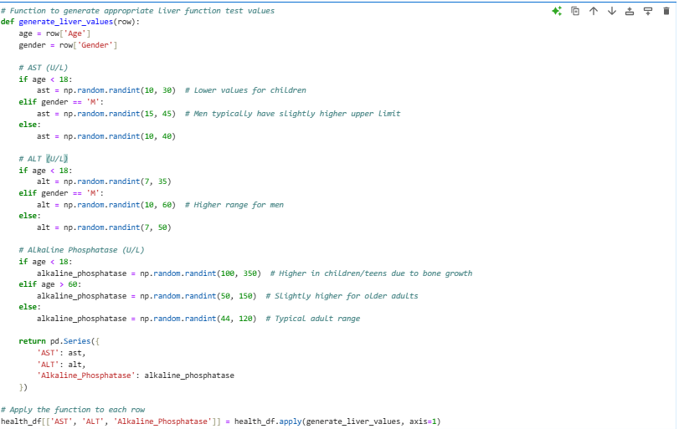

Slide 29
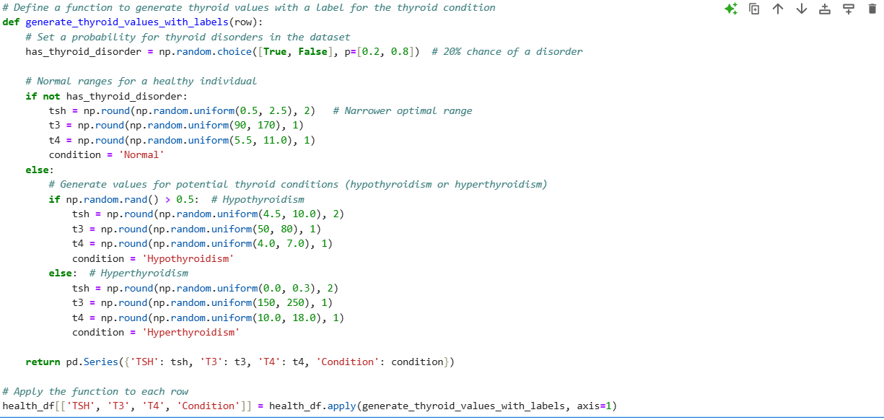
Generating Thyroid Values and Conditions
Goal: To simulate thyroid-related values (TSH, T3, T4) and categorize individuals with thyroid conditions as Normal, Hypothyroidism, or Hyperthyroidism based on predefined probabilities.
What is Thyroid Function? The thyroid gland regulates metabolism through hormones:
TSH (Thyroid Stimulating Hormone): Regulates the production of T3 and T4.
T3 (Triiodothyronine): Active form of thyroid hormone; regulates metabolism.
T4 (Thyroxine): Precursor to T3; plays a role in metabolism regulation.
20% chance of thyroid disorder (Hypo or Hyper)
80% chance of normal thyroid function.
Normal: TSH, T3, T4 within healthy ranges.
Hypothyroidism: High TSH, low T3/T4.
Hyperthyroidism: Low TSH, high T3/T4.
Condition | TSH (μU/mL) | T3 (ng/dL) | T4 (μg/dL)
Normal Function | 0.5 to 2.5 | 90 to 170 | 5.5 to 11.0
Hypothyroidism | > 4.5 | Low (50–80) | Low (4.0–7.0)
Hyperthyroidism | < 0.3 | High (150–250) | High (10.0–18.0)

Slide 30
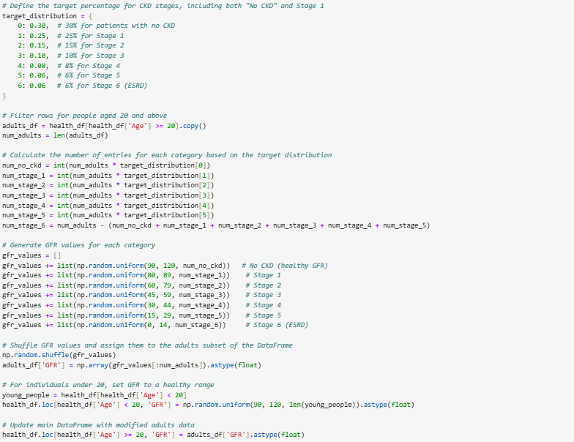
Generating GFR Values for CKD Stages
Goal: To simulate Glomerular Filtration Rate (GFR) values for Chronic Kidney Disease (CKD) stages and distribute them according to predefined target percentages.
CKD Stage | GFR Range (mL/min/1.73 m²) | Target Distribution
Stage 0 (No CKD) | 90–120 | 30%
Stage 1 | 80–89 | 25%
Stage 2 | 60–79 | 15%
Stage 3 | 45–59 | 10%
Stage 4 | 30–44 | 8%
Stage 5 | 15–29 | 6%
Stage 6 (ESRD) | 0–14 | 6%

Slide 31
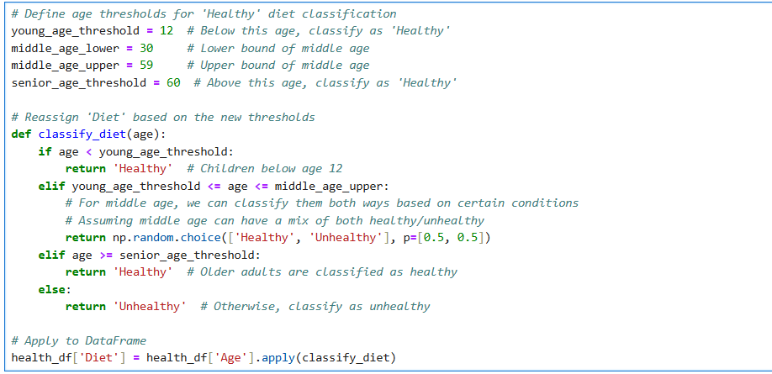
Classifying Diet Based on Age Thresholds
Goal: Classify individuals' diets as "Healthy" or "Unhealthy" based on their age.
Age Group | Age Range | Diet Classification | Diet Distribution
Children | < 12 years | Always Healthy | 100% Healthy
Middle Age | 12-59 years | Mixed (50% Healthy/Unhealthy) | 50% Healthy, 50% Unhealthy
Seniors | ≥ 60 years | Always Healthy | 100% Healthy

Slide 32
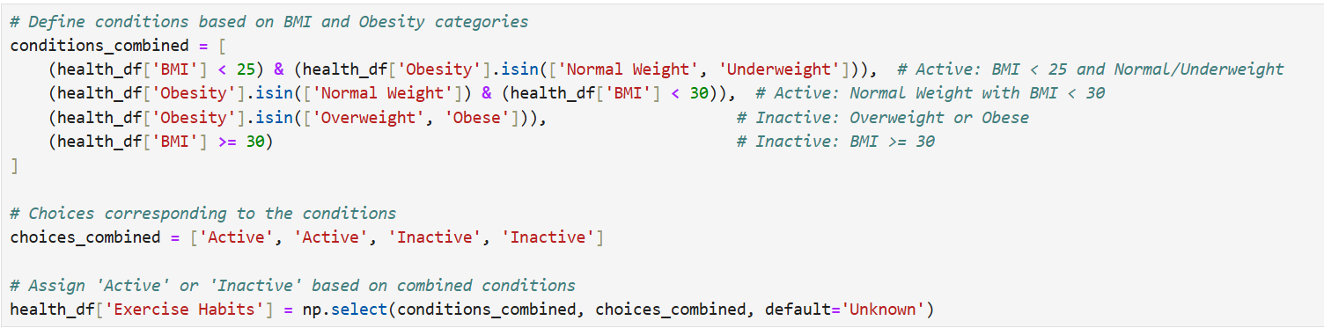
Classifying Exercise Habits Based on BMI and Obesity Categories
Goal: Classify individuals as "Active" or "Inactive" based on their BMI and obesity categories to assess exercise habits.
Active: BMI < 25 (Normal weight/Underweight) or Normal weight with BMI < 30.
Inactive: Overweight/Obese or BMI ≥ 30.
BMI and obesity categories help determine exercise habits and identify individuals for targeted health strategies.
BMI Category | BMI Range | Exercise Habit Classification
Active | BMI < 25 or BMI < 30 | Active
Inactive | BMI ≥ 30 | Inactive

Slide 33
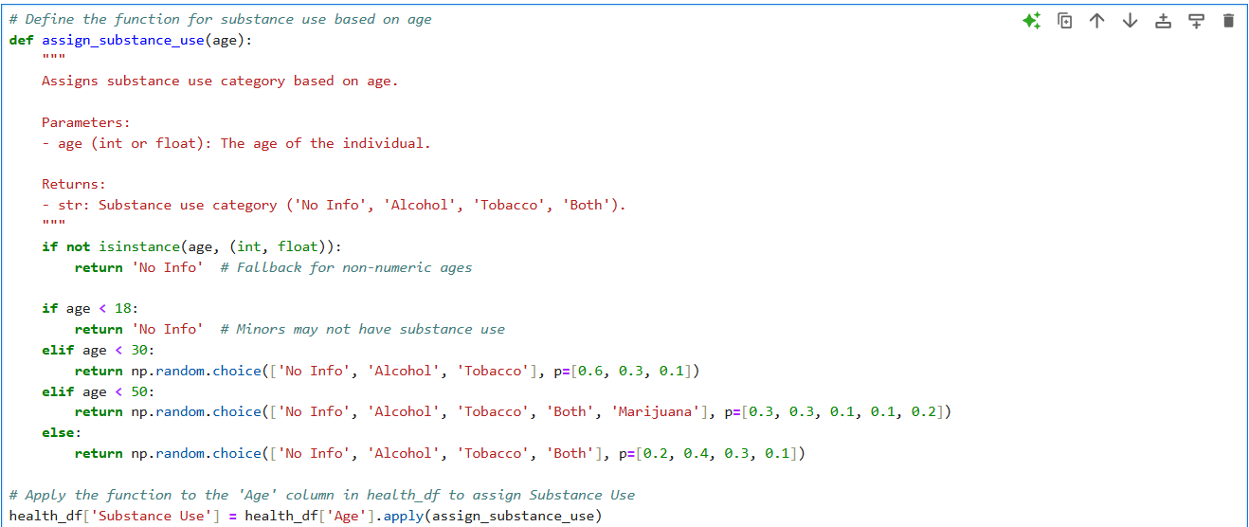
Classifying Substance Use Based on Age
Goal: Classify individuals' substance use habits based on their age group.
Age Group | Substance Use Categories | Probabilities
Under 18 | No Info | 100%
18-29 years | No Info, Alcohol, Tobacco | 60% No Info, 30% Alcohol, 10% Tobacco
30-49 years | No Info, Alcohol, Tobacco, Both, Marijuana | 30% No Info, 30% Alcohol, 10% Tobacco, 10% Both, 20% Marijuana
50+ years | No Info, Alcohol, Tobacco, Both | 20% No Info, 40% Alcohol, 30% Tobacco, 10% Both

Slide 34
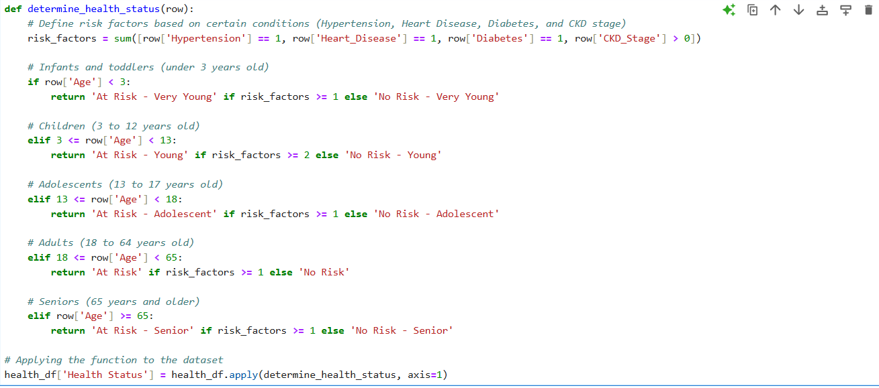
Health Status Indicator Based on Risk Factors
Goal: Classify individuals' health status based on age and risk factors (Hypertension, Heart Disease, Diabetes, and CKD Stage).
Risk Factors:
Hypertension: Present if hypertension = 1.
Heart Disease: Present if heart disease = 1.
Diabetes: Present if diabetes = 1.
CKD: Present if CKD Stage > 0.
Age Group | Risk Criteria | Health Status
Infants & Toddlers | Any risk factor (Hypertension, Heart Disease, Diabetes, CKD > 0) | "At Risk - Very Young" or "No Risk - Very Young"
Children (3-12) | 2 or more risk factors | "At Risk - Young" or "No Risk - Young"
Adolescents (13-17) | Any risk factor | "At Risk - Adolescent" or "No Risk - Adolescent"
Adults (18-64) | At least 1 risk factor | "At Risk" or "No Risk"
Seniors (65+) | At least 1 risk factor | "At Risk - Senior" or "No Risk - Senior"

Slide 35
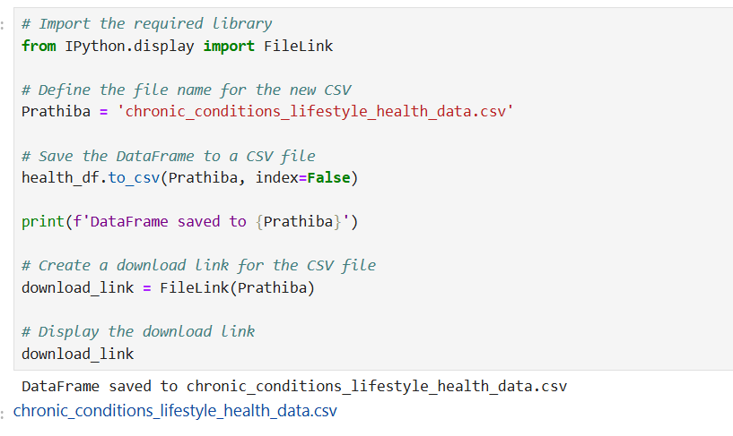
Saving and Downloading a CSV File
Save processed data to a CSV file.
Provide a downloadable link for easy access.
Create a clickable download link using FileLink.
Import Libraries for Data Science and Machine Learning.
Dataset Overview: Loaded dataset: chronic_conditions_lifestyle_health_data.csv. Displayed the last few rows to understand structure.
Dataset Dimensions: Shape: Rows: {100000}, Columns: {48}. Provides an overview of the dataset's size.
Dataset Information: Examined the data types in the dataset: 7 columns of type float64, 18 columns of type int64, 23 columns of type object and Memory Usage is approximately 36.6MB.
Column Renaming: Removed spaces from column names for uniformity. Renamed the columns by removing extra spaces using
columns.str.strip().str.replace(' ', ‘_’). Columns.str.strip().str.replace(' ', '_’). Example: Old Column Name -> Old_Column_Name.

Slide 36
Category | Libraries/Tools | Purpose
Data Visualization | Matplotlib | Static visualizations and plots.
 | Seaborn | Statistical data visualization with enhanced aesthetics.
 | Plotly | Interactive and dynamic visualizations.
 | Plotly Subplots (make_subplots) | Create subplots.
 | Plotly Graph Objects (go.Figure) | Custom visualizations.
Data Preprocessing | StandardScaler, MinMaxScaler | Scaling and normalization.
 | LabelEncoder | Encoding categorical labels.
 | train_test_split | Splitting data into train and test sets.
 | PCA | Dimensionality reduction.
Machine Learning Models | LogisticRegression, RidgeClassifier | Linear models for classification.
 | RandomForest, GradientBoosting, XGBoost | Ensemble models for robust classification.
 | SVC, GaussianNB, DecisionTreeClassifier | Support vector machines, Naive Bayes, and decision trees.
Model Evaluation | Accuracy, F1 Score, Precision, Recall, ROC-AUC | Metrics for assessing model performance.
 | UndefinedMetricWarning | Handle exceptions and warnings related to metrics.
Feature Selection | RFE (Recursive Feature Elimination) | Select important features iteratively.
Outlier Detection | IsolationForest | Detect anomalies in the data.
Parallel Processing | Joblib | Efficient computation in multi-core environments.
Statistical Tests | ttest_rel | Conduct paired sample t-tests.
Timing & Performance | time | Measure execution time.
Text Adjustment | adjustText | Avoid overlap in text annotations for visualizations.

Slide 37
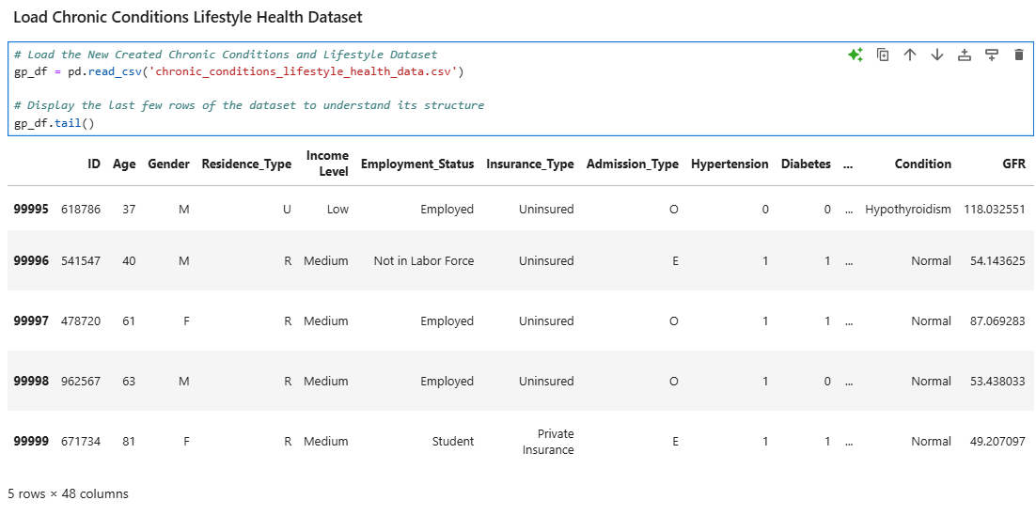
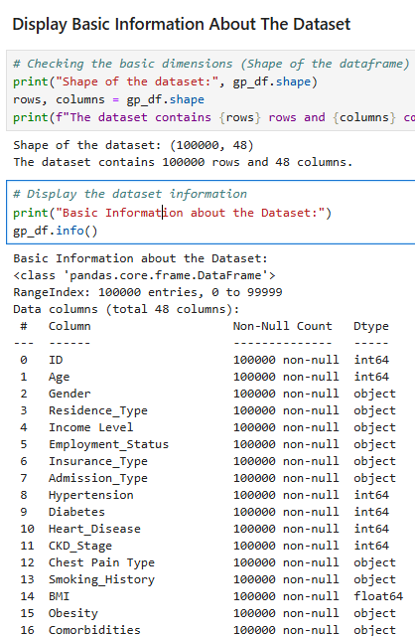
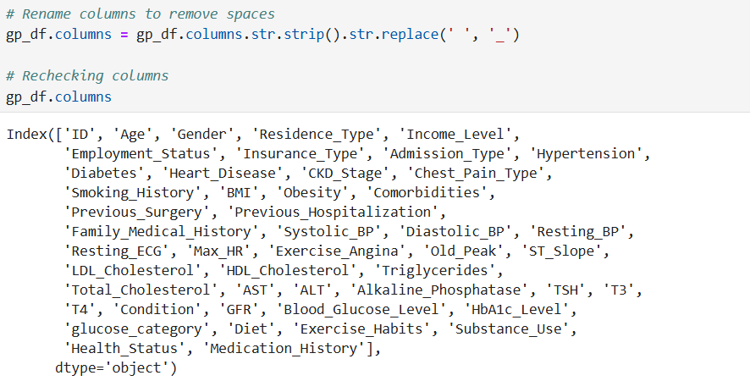
s

Slide 38
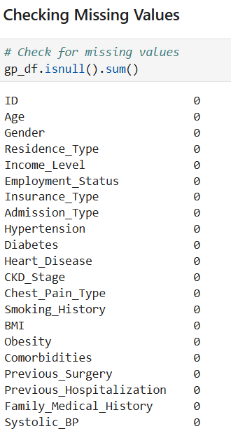
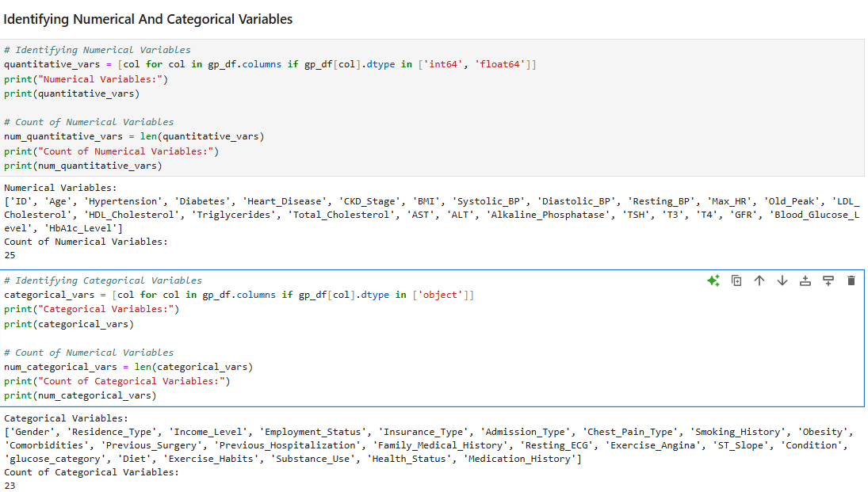
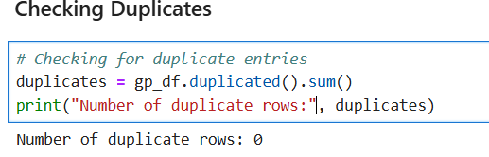
DATA CLEANING AND DATA PREPROCESSING
Data preprocessing is an essential step in any analysis. It involves preparing the dataset for further analysis by performing the following tasks:
Checking for duplicate records: Ensuring data quality by identifying and removing duplicates. In our dataset, there were no duplicate rows.
Identifying and handling missing values: This step may involve imputation or removal of missing data. In our analysis, as we have incorporated all the columns and rows as per our requirements, there were no missing values.
Distinguishing between numerical and categorical variables: This allows for the application of appropriate preprocessing techniques, such as encoding categorical variables or scaling numerical ones. Our dataset contains a total of 25 numerical variables and 23 categorical variables.

Slide 39
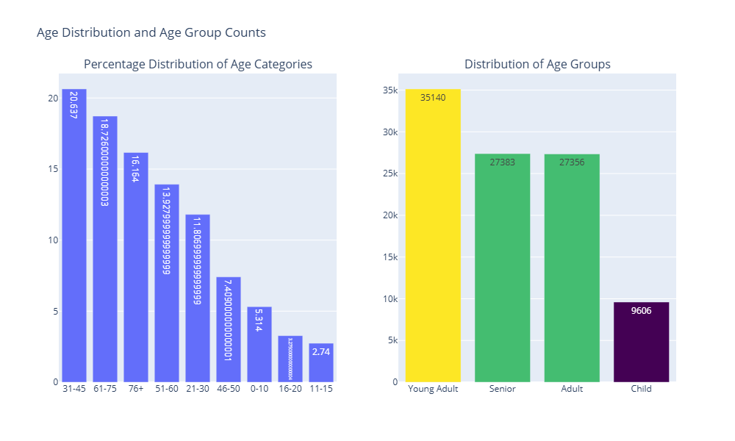
EXPLORATORY DATA ANALYSIS (EDA)
A critical process of understanding data through statistical and graphical methods.
Helps in identifying patterns, detecting anomalies, and summarizing key characteristics of the dataset.
AGE DISTRIBUTION ANALYSIS
1. Defined age categories for analysis:
Age Bins: [0-10, 11-15, 16-20, 21-30, 31-45, 46-50, 51-60, 61-75, 76+]
Age Group Bins: 'Child', 'Young Adult', 'Adult', 'Senior'
Percentage Distribution of Age Categories:

Slide 40
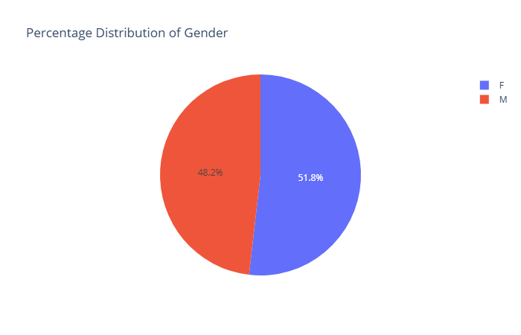
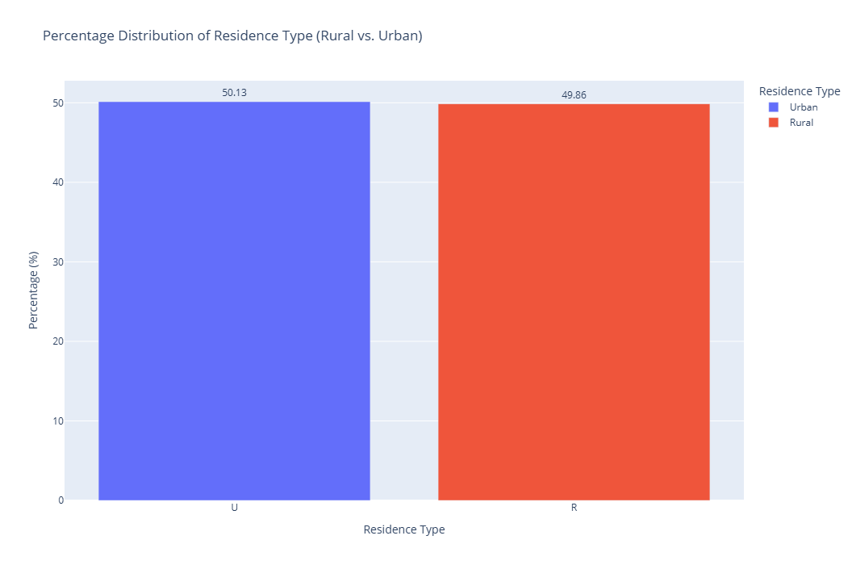
GENDER DISTRIBUTION ANALYSIS
Calculate and visualize the distribution of gender within the dataset.
The dataset's gender distribution is almost balanced:
Females: 51.82% (51,821 individuals)
Males: 48.18% (48,179 individuals)
The analysis highlights a slight female predominance in the dataset
RESIDENCE TYPE DISTRIBUTION ANALYSIS
Analyze the distribution of residence types (Rural vs. Urban) in the dataset.
The dataset is evenly distributed between rural and urban populations: Urban: 50.14% (50,135 individuals) and Rural: 49.87% (49,865 individuals).

Slide 41
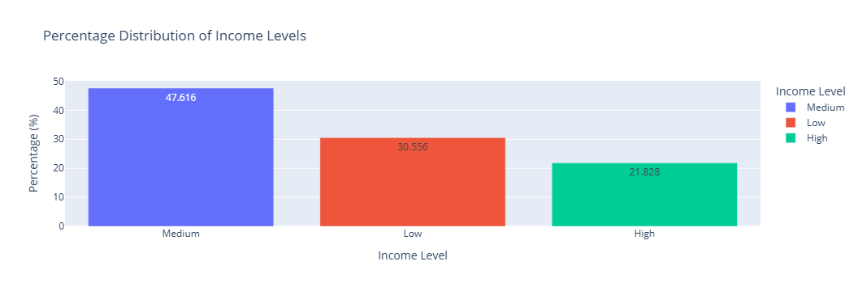
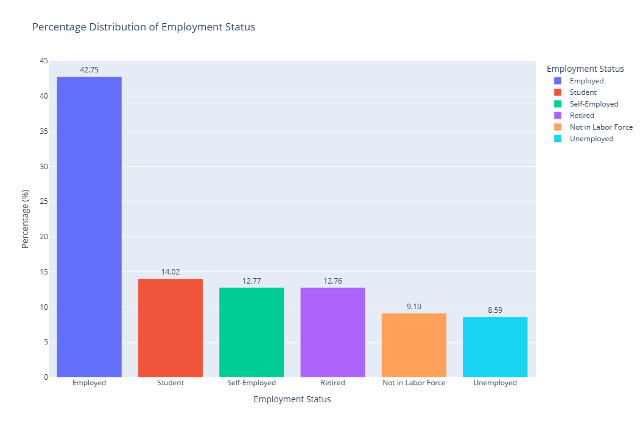
INCOME LEVEL DISTRIBUTION ANALYSIS
Analyze the total count and percentage distribution of income levels in the dataset.
Income levels are distributed as follows:
Medium Income: 47.62% (47,616 individuals)
Low Income: 30.56% (30,556 individuals)
High Income: 21.83% (21,828 individuals)
EMPLOYMENT STATUS DISTRIBUTION ANALYSIS
Analyze the total count and percentage distribution of employment status categories.

Slide 42
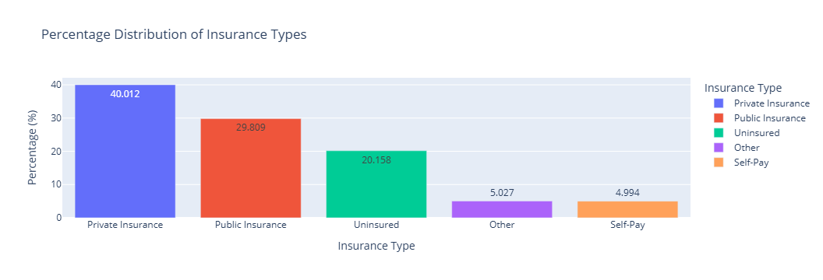
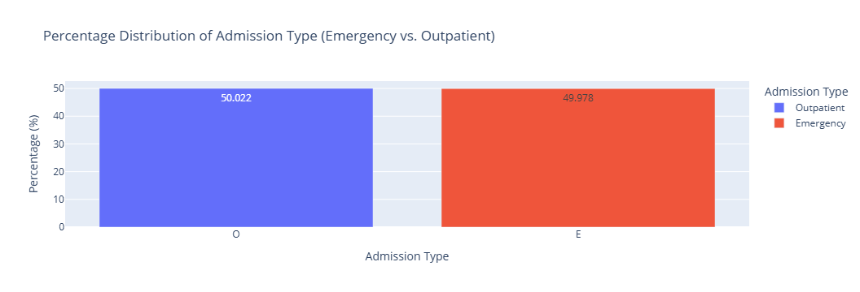
INSURANCE TYPE DISTRIBUTION ANALYSIS
Analyze the total count and percentage distribution of insurance types.
ADMISSION TYPE DISTRIBUTION ANALYSIS
Analyze the total count and percentage distribution of admission types (Emergency vs. Outpatient).

Slide 43
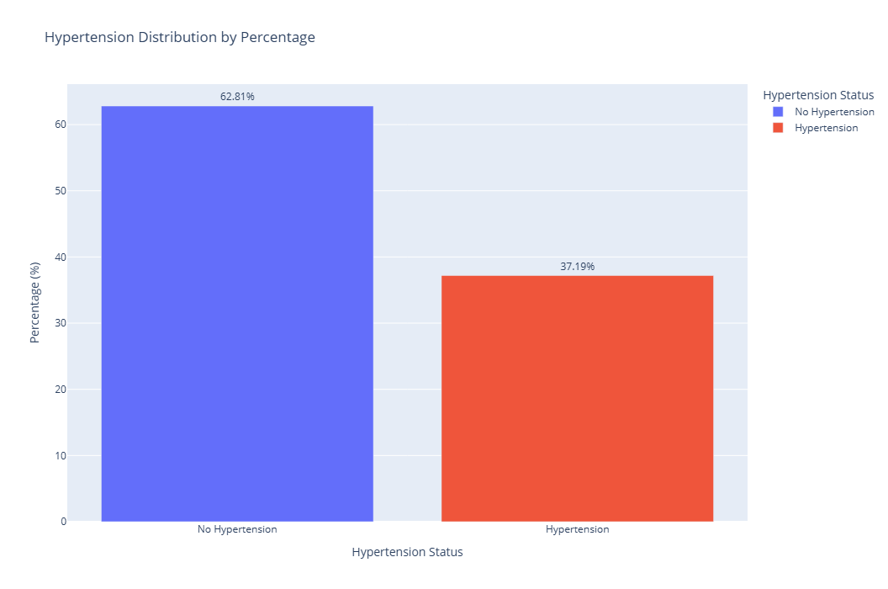
HYPERTENSION DISTRIBUTION BY PERCENTAGE
Hypertension Status:
No Hypertension (0): 62.81% (62,808 individuals)
Hypertension (1): 37.19% (37,192 individuals)
The data highlights that a significant majority of the population does not have hypertension, while about one-third are hypertensive.

Slide 44
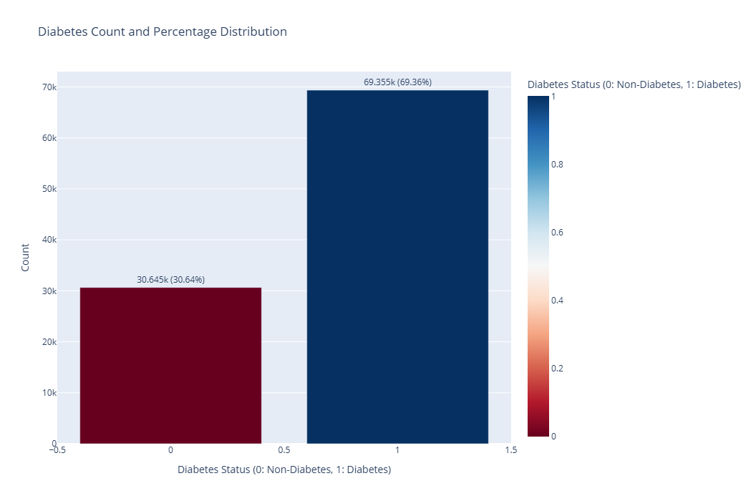
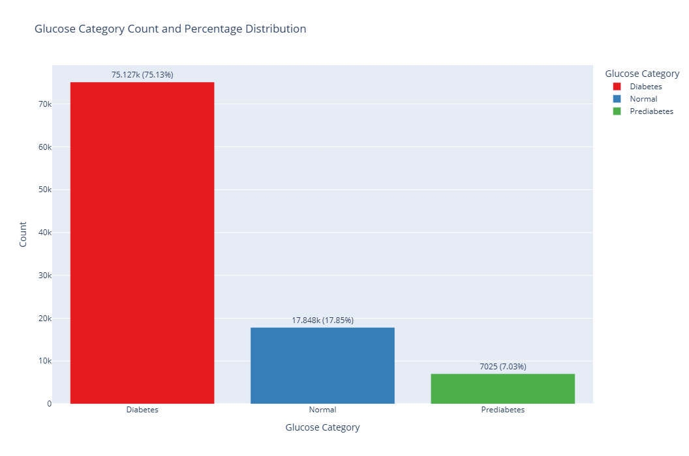
DIABETES DISTRIBUTION BY PERCENTAGE
Key Insights:
Diabetes (1): 69.36%
Non-Diabetes (0): 30.64%
Glucose Category Distribution
Key Insights:
Diabetes: 75.13%
Normal: 17.85%
Prediabetes: 7.03%

Slide 45
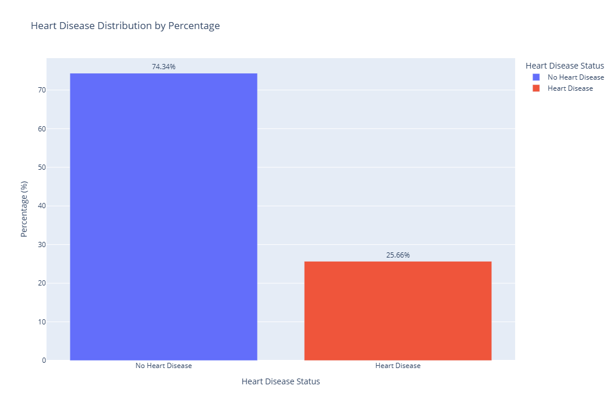
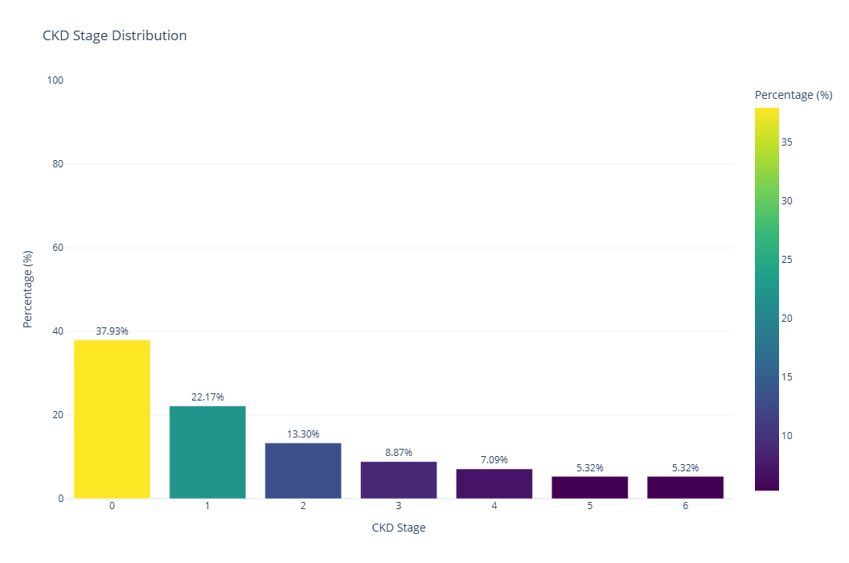
HEART DISEASE DISTRIBUTION BY PERCENTAGE
Key Insights:
No Heart Disease (0): 74.34%
Heart Disease (1): 25.66%
CKD STAGE DISTRIBUTION BY PERCENTAGE
Stage 0: 37.93%
Stage 1: 22.17%
Stage 2: 13.30%
Stage 3: 8.87%
Stage 4: 7.09%
Stage 5: 5.32%
Stage 6: 5.32%

Slide 46
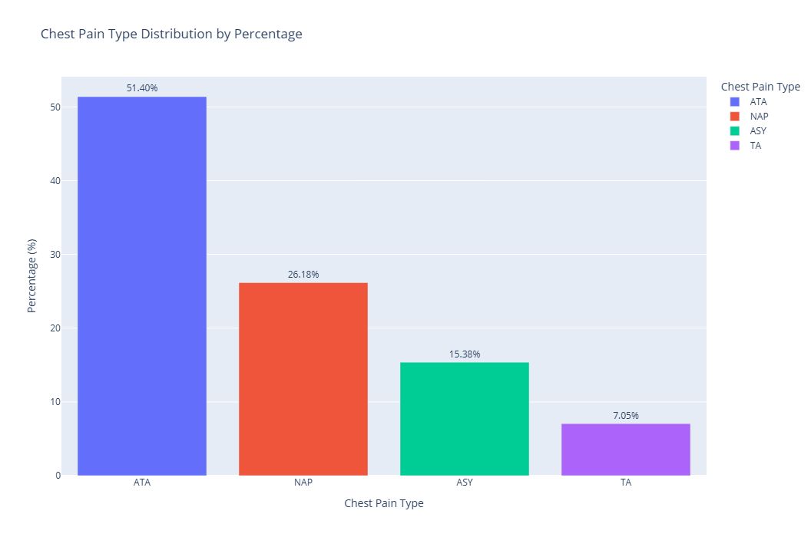
PERCENTAGE DISTRIBUTION OF CHEST PAIN TYPES
The percentage distribution of chest pain types observed:
ATA: 51.40%
NAP: 26.18%
ASY: 15.38%
TA: 7.05%

Slide 47
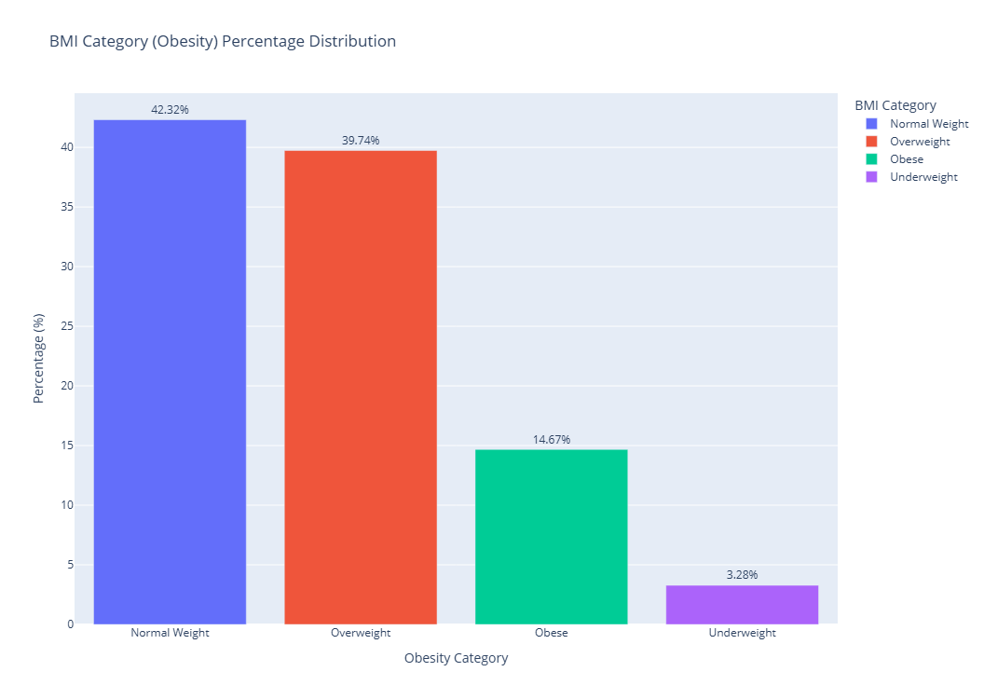
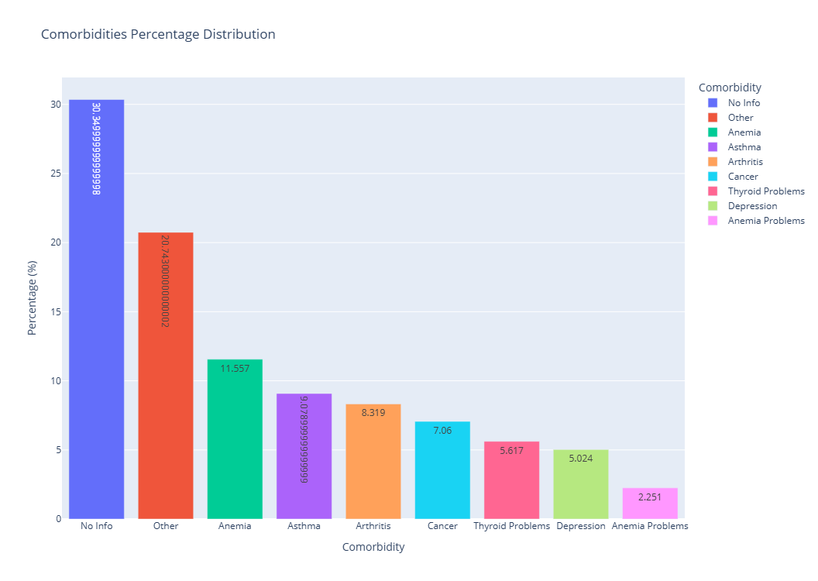
PERCENTAGE DISTRIBUTION OF BMI AND OBESITY
PERCENTAGE DISTRIBUTION OF CO-MORBIDITIES

Slide 48
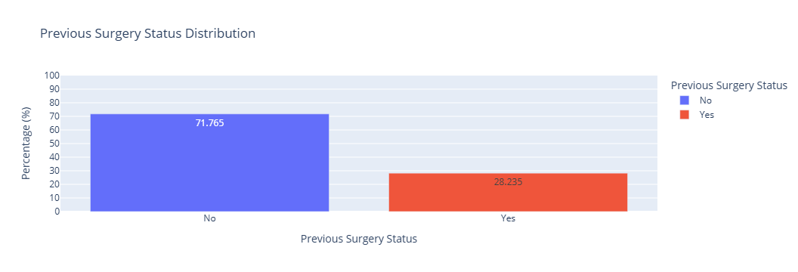
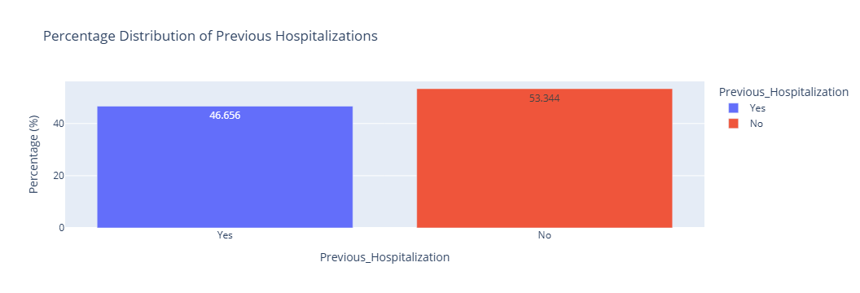
PERCENTAGE DISTRIBUTION OF PREVIOUS SURGERY
PERCENTAGE DISTRIBUTION OF PREVIOUS HOSPITALIZATION

Slide 49


PERCENTAGE DISTRIBUTION OF FAMILY HISTORY
PERCENTAGE DISTRIBUTION OF SMOKING HISTORY

Slide 50


Resting BP Percentage Distribution
Resting ECG Percentage Distribution
Resting BP ranges: 90-110, 111-130, 131-150, 151-170, 171-190.
Largest distribution: 111-130 (27.68%).
Two categories: Normal (75.97%) and ST (24.03%).
Most patients have a normal ECG.

Slide 51


EXERCISE ANGINA PERCENTAGE DISTRIBUTION
OLD PEAK PERCENTAGE DISTRIBUTION
Old Peak ranges: 0-1, 1-2, 2-3, 3-4, 4-5, 5-6.
Largest distribution: 1-2 (34.28%).
Smallest: 5-6 (5.24%).
Two categories: No (73.94%) and Yes (26.06%).
Majority do not experience angina during exercise.

Slide 52

ST SLOPE PERCENTAGE DISTRIBUTION
Three categories: Up (52.01%), Flat (35.32%), and Down (12.68%).
Upward slopes are most common

Slide 53



LIPID PROFILE CLASSIFICATION
Total Cholesterol: Classified as Normal, Borderline High, High.
LDL Cholesterol: Categories from Optimal to Very High.
Triglycerides: Classified as Normal, Borderline High, High.

Slide 54



LIVER ENZYME DISTRIBUTION
AST, ALT, Alkaline Phosphatase: Low, Normal, High categories with percentage distributions.
AST and ALT mostly within Normal range.
Alkaline Phosphatase has higher variability.

Slide 55

THYROID CONDITION DISTRIBUTION
Normal: 80.03%
Hyperthyroidism: 10.04%
Hypothyroidism: 9.93%

Slide 56


DIET DISTRIBUTION
Healthy: 70.9%
Unhealthy: 29.1%
EXERCISE HABITS DISTRIBUTION
Inactive: 54.4%
Active: 45.6%

Slide 57


SUBSTANCE USE DISTRIBUTION
Health Status Distribution

Slide 58
FEATURE ENGINEERING
Objective: We have conducted unique data visualizations to gain deeper insights into our dataset. This involved combining multiple features to create new columns and analyzing their percentage distribution.
Importance: Feature engineering helps in identifying key relationships between variables. For instance, by combining features like hypertension, we can explore how many individuals with hypertension also have conditions like chronic kidney disease (CKD) or heart disease.
Impact on Analysis: These visualizations provide a clear understanding of how different conditions (e.g., hypertension) affect the likelihood of other health outcomes. In subsequent steps, we will delve into the specific features that influence these conditions.

Slide 59


PERCENTAGE OF INDIVIDUALS WITH BOTH HYPERTENSION AND DIABETES
PERCENTAGE OF INDIVIDUALS WITH BOTH HYPERTENSION AND HEART DISEASE

Slide 60


PERCENTAGE OF INDIVIDUALS WITH BOTH HYPERTENSION AND CKD
PERCENTAGE OF INDIVIDUALS WITH BOTH DIABETES AND HEART DISEASE

Slide 61


PERCENTAGE OF INDIVIDUALS WITH BOTH HEART DISEASE AND CKD
PERCENTAGE OF INDIVIDUALS WITH BOTH DIABETES AND CKD

Slide 62

PERCENTAGE OF INDIVIDUALS WITH HYPERTENSION, DIABETES, HEART DISEASE, AND CKD
Bar chart showing percentages (92.797% without, 7.203% with all conditions).
A small percentage of patients suffer from all four conditions, requiring intensive care.

Slide 63
MODEL PREPARATION
Handling Categorical Variables
Applied Ordinal Encoding with predefined mappings. Example Gender: M → 0, F → 1, Chest_Pain_Type: NAP → 0, ASY → 1, ATA → 2, TA → 3
2. Converting Data Types
Ensure consistency in numerical data by converting all values to a single type:
Integer or Float
Avoids errors like "could not convert int to float.
3. Feature Selection
Independent Variables (X): Dropped target and irrelevant columns.
Include: Age, Gender, Income Level, AST, ALT, Total Cholesterol, TSH, etc.
Exclude: Target Variables (Diabetes, Hypertension, Heart Disease, CKD).
Exclude: Categorical variables like Family History & Medication History (analyzed separately).
Target Variables (y):
Diabetes, Hypertension, Heart Disease, CKD.
4. Splitting the Dataset
Dataset split using train_test_split:
70% Training Data
30% Testing Data
5. Standardization
Applied StandardScaler for normalizing features.
Feature scaling brings all features to a common scale to avoid bias, ensuring optimal performance of machine learning models:
Example:
Blood Glucose: mg/dL
GFR: mL/min
Standardized values allow fair contribution from all features.

Slide 64






Slide 65
PRINCIPAL COMPONENT ANALYSIS (PCA)
KEY BENEFITS OF PCA:
Reduces data dimensionality.
Retains the most important information.
OBJECTIVE:
Calculate statistical measures (mean, variance, covariance) for Systolic and Diastolic BP.
Perform Principal Component Analysis (PCA) to analyze relationships and reduce dimensions.
Interpret PCA results and understand variance contribution by components.
APPROACH:
Perform PCA without standardization.
Perform PCA with standardization for comparison.

Slide 66
STATISTICAL ANALYSIS:
STEPS IN PCA ANALYSIS:
Standardize the data.
Compute covariance matrix.
Project data onto principal components.
TOOL USED: Python's sklearn.decomposition.PCA
Principal Component Analysis (PCA) - Summary of Statistics
Features | Means | Variances | Covariance
Systolic Blood Pressure | 134.93 | 451.83 | 240.48
Diastolic Blood Pressure | 87.32 | 214.21

Slide 67
Principal Component Analysis (PCA) - Results
PC Results | Explained Variance | Cumulative Variance
PC 1 | 90.27% | 90.27%
PC 2 | 9.73% | 100%
Variable | PC1 Weight | PC2 Weight
Systolic BP | 0.8494 | -0.5278
Diastolic BP | 0.5278 | 0.8494
PCA SCORES: PCA Scores of First 5 Observations:
Observation | PC1 | PC2
1 | -11.66 | -3.73
2 | -17.07 | 0.81
3 | -18.36 | 6.32
4 | -21.53 | 1.23
5 | -21.85 | 2.6

Slide 68


EXPANDED PCA ANALYSIS
Apply preprocessing by standardizing the data using a scaling function and removing categorical columns, such as 'Family Medical History,' 'Condition,' 'Health Status,' and 'Medication History.

Slide 69

CONCLUSION:
Strong covariance between Systolic and Diastolic BP (240.48).
PCA shows PC1 dominates the variance (90.27%).
PCA has reduced the dimensions of the data from two variables (Systolic and Diastolic BP) to two principal components.
PC1 explains most of the variance (90.27%), making it the primary component in the dataset.
Further analysis can be performed to understand how these components relate to other health conditions (e.g., hypertension, heart disease).

Slide 70
ANOMALY DETECTION USING ISOLATION FOREST
OBJECTIVE
Detect and analyze anomalies in a healthcare dataset using Isolation Forest.
Investigate feature-wise statistics for anomalies and normal records.
WHY ANOMALY DETECTION MATTERS
Identifies rare conditions or errors in data.
Improves the quality of downstream analysis.
DATASET DESCRIPTION
Total records: 100,000.
Features include demographics, medical history, test results, and more.
Focus on numerical features for anomaly detection.

Slide 71
WHAT IS ISOLATION FOREST?
An unsupervised learning algorithm for anomaly detection.
Isolates anomalies based on their distance from other data points.
PARAMETERS USED
Contamination rate: 5% (to detect 5% of records as anomalies).
IMPLEMENTATION STEPS
Preprocessed the dataset to include only numerical columns.
Trained Isolation Forest model with contamination rate = 0.05.
Predicted anomalies:
-1 for anomalies. (-1: Represents an anomaly (outlier) in the dataset.)
1 for normal records. (1: Represents a normal (non-anomalous) record.)
4. Computed feature-wise statistics for anomalies and normal records.

Slide 72
ANOMALIES DETECTED
Total anomalies: 5,000
Percentage of anomalies: 5.00%.
OBERVATIONS: Patterns observed in anomalous records:
Higher mean values in some features (e.g., Smoking History, Co-morbidities).
Anomalous patients often have more severe medical conditions.
Normal records show consistent trends across features.
CONCLUSION
Isolation Forest effectively identified 5% anomalies in the dataset.
Anomalous records provide insights into rare or unexpected patterns.
Feature-wise analysis highlights differences between anomalies and normal.

Slide 73

EXAMPLE
The scatterplot highlights anomalies using red dots and normal points using blue dots.
Outliers in HbA1c Level and GFR indicating abnormal metabolic or kidney functions.

Slide 74
RECURSIVE FEATURE ELIMINATION (RFE)
RECURSIVE FEATURE ELIMINATION
WHAT IS RFE?
A feature selection technique that iteratively removes the least significant features.
Works with machine learning models to rank feature importance.
WHY USE RFE?
Reduces dimensionality for better model performance.
Improves interpretability of features in prediction tasks.
METHODOLOGY
Initialize the model (RandomForestClassifier in this case).
Loop through each target variable:

Slide 75


Use scaled training data.
Apply RFE to select a specified number of features.
Fit the model and evaluate its accuracy.
3. Store selected features and accuracy results for each target.
KEY STEPS:
Fit RFE for each target variable.
Select top features based on RFE rankings.
RESULTS SUMMARY

Slide 76


ACCURACY COMPARISONS:
Accuracy of RFE-selected features for each target variable

Slide 77




FEATURE IMPORTANCE FOR DIABETES
FEATURE IMPORTANCE FOR HYPERTENSION

Slide 78




FEATURE IMPORTANCE FOR HEART DISEASE
FEATURE IMPORTANCE FOR CKD STAGE

Slide 79
MULTI OUTPUT-TARGET CLASSIFICATION ANALYSIS
Concept: A single model is trained to predict multiple target variables simultaneously, treating each target as an independent classification problem. Each target variable is predicted in parallel. The model does not assume any dependency between the targets.
Advantages
Simplifies implementation since all outputs are handled at once.
Can efficiently handle tasks with minimal interdependencies among labels.
Disadvantages
Does not account for correlations between labels, which may reduce performance for interdependent tasks.
Example: If we are predicting whether a person has "hypertension" and "diabetes," the model predicts them as separate, independent problems in a single pass.

Slide 80
MULTI OUTPUT-TARGET CLASSIFICATION ANALYSIS
1. Data Sampling and Splitting
70% of the data is sampled for training and testing.
Data is split into training (70%) and testing (30%) using stratified sampling to preserve target distributions.
2. Feature and Target Definitions
Features include demographic, clinical, and behavioral data.
Targets: Hypertension, Diabetes, Heart_Disease, and CKD_Stage.
3. Data Standardization
Standardized with StandardScaler to ensure mean = 0 and standard deviation = 1.

Slide 81
4. Classifier Setup
Models: Random Forest, Logistic Regression, Decision Tree, Gradient Boosting, XGBoost, Naive Bayes, Extra Trees, Ridge Classifier.
MultiOutputClassifier handles multi-target classification.
5. Model Training and Evaluation
Metrics: Accuracy, F1-score for each target, aggregated for overall performance.
Evaluated separately per target and averaged for model comparison.
6. Model Performance Observations
Hypertension, Diabetes: High accuracy and F1-scores.
Heart_Disease: Moderate performance; room for improvement.
CKD_Stage: Most challenging with lower scores.

Slide 82
7. Model Comparisons
Top Performers: Random Forest, Gradient Boosting, XGBoost.
Simpler Models: Naive Bayes and Logistic Regression excel in binary targets but struggle with CKD_Stage.
Best Model: Selected based on highest average F1-score across all targets.
MultiOutput Classifier
Classifier | Hypertension Accuracy | Hypertension F1 Score | Diabetes Accuracy | Diabetes F1 Score | Heart Disease Accuracy | Heart Disease F1 Score | CKD Stage Accuracy | CKD Stage F1 Score | Average Accuracy | Average F1 Score | Timing
Random Forest | 1.00 | 1.00 | 0.99 | 0.99 | 0.81 | 0.75 | 0.29 | 0.17 | 0.77 | 0.73 | 10.96 Minutes
Logistic Regression | 1.00 | 1.00 | 0.99 | 0.98 | 0.80 | 0.75 | 0.35 | 0.15 | 0.78 | 0.72 | 5.82 seconds
Decision Tree | 1.00 | 1.00 | 0.99 | 0.99 | 0.75 | 0.70 | 0.21 | 0.16 | 0.74 | 0.71 | 2.15 seconds
Gradient Boosting | 1.00 | 1.00 | 0.99 | 0.98 | 0.82 | 0.76 | 0.37 | 0.11 | 0.79 | 0.71 | 512.40 seconds
XGBoost | 1.00 | 1.00 | 0.99 | 0.99 | 0.82 | 0.75 | 0.38 | 0.10 | 0.80 | 0.71 | 267.03 seconds
Naive Bayes | 0.95 | 0.95 | 0.98 | 0.98 | 0.81 | 0.76 | 0.35 | 0.13 | 0.77 | 0.70 | 0.38 seconds
Extra Trees | 1.00 | 1.00 | 0.99 | 0.99 | 0.80 | 0.75 | 0.29 | 0.17 | 0.77 | 0.73 | 7.84 seconds
Ridge Classifier | 0.99 | 0.99 | 0.95 | 0.94 | 0.82 | 0.76 | 0.37 | 0.11 | 0.78 | 0.70 | 0.47 seconds

Slide 83



Slide 84
CHAINED MULTIOUTPUT CLASSIFICATION ANALYSIS
Concept: Multiple models are used sequentially, where each model predicts one target variable at a time. The key difference is that each subsequent model has additional information from the predictions of the previous models.
How it works: The model predicting one target (e.g., "hypertension") can use the prediction of another target (e.g., "diabetes") as an additional feature for better prediction.
Example: For predicting "has hypertension" and "has diabetes," the model predicting "has diabetes" may use the prediction from "hypertension" as a feature.

Slide 85
CHAINED MULTI OUTPUT CLASSIFICATION ANALYSIS
OBJECTIVE: To compare various classification algorithms for a multi-output classification task using Chain Multioutput Classifier.
SCOPE:
Explore model performances on targets: Hypertension, Diabetes, Heart Disease, CKD Stage.
Evaluate metrics: Accuracy and F1 Score.
Identify the best-performing model overall and for each target.
CLASSIFIERS: Algorithms used are Random Forest, Logistic Regression, Decision Tree, Gradient Boosting, XG Boost, Naive Bayes, Extra Trees, Ridge Classifier.
NOTE: All models are wrapped with ClassifierChain for multi-output prediction.

Slide 86
KEY INSIGHTS
Random Forest and Gradient Boosting showed strong performance for most targets.
Gradient Boosting and XGBoost had the highest average accuracy and F1 scores.
CKD Stage predictions were challenging, highlighting areas for improvement.
MODEL COMPARISONS
Top Performers: Random Forest, Gradient Boosting, XGBoost.
Simpler Models: Naive Bayes and Logistic Regression excel in binary targets but struggle with CKD_Stage.

Slide 87



Slide 88
COMPARISON OF MULTIOUTPUT vs. CHAINED MULTIOUTPUT CLASSIFIER
KEY DIFFERENCE
Multioutput Classifier treats all labels as independent, while Chained Multioutput Classifier models the relationships between labels for better prediction accuracy.
SUMMARY:
Best Accuracy: XGBoost with Multioutput (0.80).
Best F1 Score: XGBoost with ChainedMultioutput Classifier (0.77).

Slide 89

Classifier | Multioutput Classifier |  | Chained Multioutput Classifier
 | Average Accuracy | Average F1 Score | Average Accuracy | Average F1 Score
Random Forest | 0.77 | 0.73 | 0.78 | 0.72
Logistic Regression | 0.78 | 0.72 | 0.78 | 0.71
Decision Tree | 0.74 | 0.71 | 0.77 | 0.70
Gradient Boosting | 0.79 | 0.71 | 0.79 | 0.71
XGBoost | 0.80 | 0.71 | 0.80 | 0.71
Naive Bayes | 0.77 | 0.70 | 0.77 | 0.70
Extra Trees | 0.77 | 0.73 | 0.78 | 0.71
Ridge Classifier | 0.78 | 0.70 | 0.78 | 0.70

Slide 90
HYPOTHESIS TESTING
Purpose: Evaluate whether there is a significant difference in the performance of Multioutput Classifier vs. Chained Multioutput Classifier.
ACCURACY HYPOTHESIS TESTING:
Paired t-test: T-statistic = -1.000 and P-value = 0.391
Conclusion : Fail to reject the null hypothesis: No significant difference in accuracy between Multioutput Classifier and Chained Multioutput Classifier.
F1 SCORE HYPOTHESIS TESTING
Paired t-test: T-statistic = 1.000 and P-value = 0.391
Conclusion: Fail to reject the null hypothesis: No significant difference in F1 scores between Multioutput Classifier and Chained Multioutput Classifier.

Slide 91
CONCLUSION
1. Classifier Performance (Accuracy & F1 Score):
High Performance for Binary Targets: Most classifiers, especially more complex models like Random Forest, Gradient Boosting, and XGBoost, show high accuracy and F1 scores for targets like Hypertension and Diabetes, which are binary classification tasks.
Moderate Performance for Heart Disease: The Heart Disease target shows moderate performance across the models, indicating that it may be slightly more challenging due to its complexity or imbalanced class distribution.
Difficulty in Predicting CKD Stage: CKD Stage proves to be the most challenging target variable, with significantly lower accuracy and F1 scores across all classifiers. This could be due to the multi-class nature of the problem (with stages ranging from 1 to 5) and potentially imbalanced or less distinguishable class distributions

Slide 92
2. Model Comparisons
Strong Models: Complex models like Random Forest, Gradient Boosting, and XGBoost consistently perform better, likely due to their ability to capture complex patterns and interactions between features. These models are particularly strong in multi-output classification, where multiple targets are being predicted simultaneously.
Simpler Models Struggle: Simpler models such as Naive Bayes and Logistic Regression perform well for binary classification tasks (like Hypertension and Diabetes) but struggle with more complex targets like Heart Disease and CKD Stage. This suggests that these models might be too simplistic to capture the nuances in the data for more complex, multi-class targets.
3. Training Time:
Complex Models Require More Time: More complex classifiers, such as Random Forest, Gradient Boosting, and XGBoost, generally require more time to train. While these models provide better performance, the trade-off is increased computational cost and training time.

Slide 93
Faster Training for Simpler Models: Models like Naive Bayes and Logistic Regression have faster training times due to their simpler structure, but they may not perform as well for more complex targets. This suggests that while these models are more computationally efficient, they may not be the best choice when aiming for higher accuracy or F1 scores across all targets.
4. Model Selection: For maximizing accuracy and F1 score across all targets, Random Forest, Gradient Boosting, and XGBoost are top choices, offering a good balance of performance and complexity, especially for multi-output tasks. If training time is a priority and targets are simpler (e.g., binary classification like Hypertension or Diabetes), consider Naive Bayes or Logistic Regression. For complex tasks like CKD Stage prediction, more sophisticated models are recommended.
Future Improvements
CKD Stage Prediction: Enhance performance through feature engineering, data balancing, or advanced techniques like ensemble learning or stacking.

Slide 94
Hyperparameter Tuning: Use methods like Grid Search or Random Search to optimize model performance.
Feature Importance: Focus on key features to improve predictions, particularly for Heart Disease and CKD Stage.
General Observations: Choosing the right classifier depends on problem complexity, target nature, and computational resources. While performance metrics like accuracy and F1 score are important, training time is a key consideration for real-time applications.
Random Forest, Gradient Boosting, and XGBoost perform best but are more time-consuming, while Naive Bayes and Logistic Regression are faster but less effective for multi-class tasks like CKD Stage. Predicting CKD Stage is the biggest challenge and may require further refinement.

